Slide 1
Varna mobilnost
08.12.2017
Ljubljana
Violeta Bulc
Evropska komisarka za promet
Notes:
Purpose of Slide: Introduce CVB

Slide 2
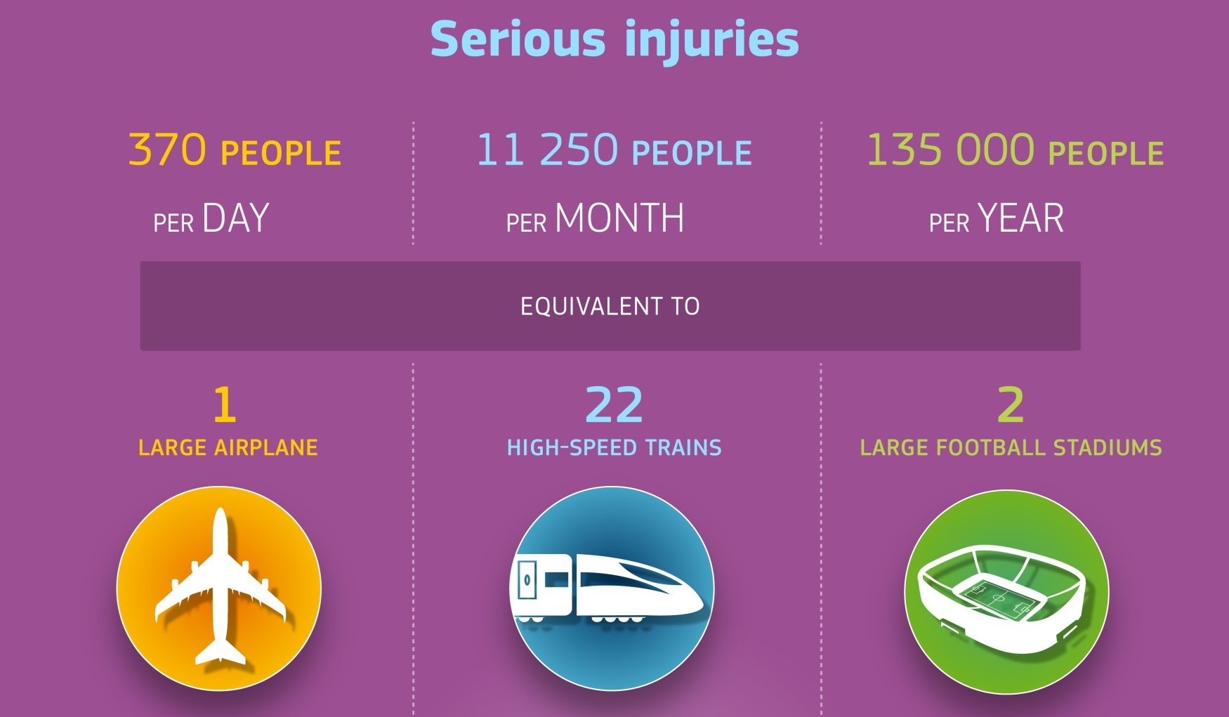

Slide 3


Slide 4


Slide 5


Hvala za pozornost
@Bulc_EU
twitter.com/Bulc_EU
facebook.com/VioletaBulc.EU
Notes:
Purpose of Slide: To end presentation

