Slide 1
AGENDA 2030
What: the goals of sustainable development. All goals are important and interconnected. In other words, one goal cannot be achieved without another.
Who: Goals are relevant for all of us: countries, municipalities, businesses, schools, you and me. Everyone can participate with their choices and by disseminating information about the goals and by promoting political decision making as a way to a better future.
Why: to make the world a better place for us all, acknowledging points of view of environment, human rights and economic.

Slide 2
Agenda 2030 deck of cards contains three cards for each Sustainable Development Goal:
The first card presents a summary of the Goal.
The second card contains a short orientation activity that can be completed alone or in teams. The cards can be used to build an activities circuit.
The third card contains a broader activity.
Some cards contain additional materials found by following the link on the card.

Slide 3
Tips for using presentation cards
Consider actions, such as "Replacing plastic straws with metal ones". Build a pyramid by setting the card most related to this action as the highest card of the pyramid. Set the cards a little less related to the action to the next level of the pyramid etc.
Discuss together how well you think your country is succeeding in implementing the Agenda 2030 Goals. For example, mark the following three headings “high”, “medium”, “low”, and ask the participants to place the cards under the headings.
Or, mark a continuum with one end to express “high level of implementation” and other end expressing “low level of implementation”, and ask the participants to place the cards on the continuum, based on their evaluations.

Slide 4

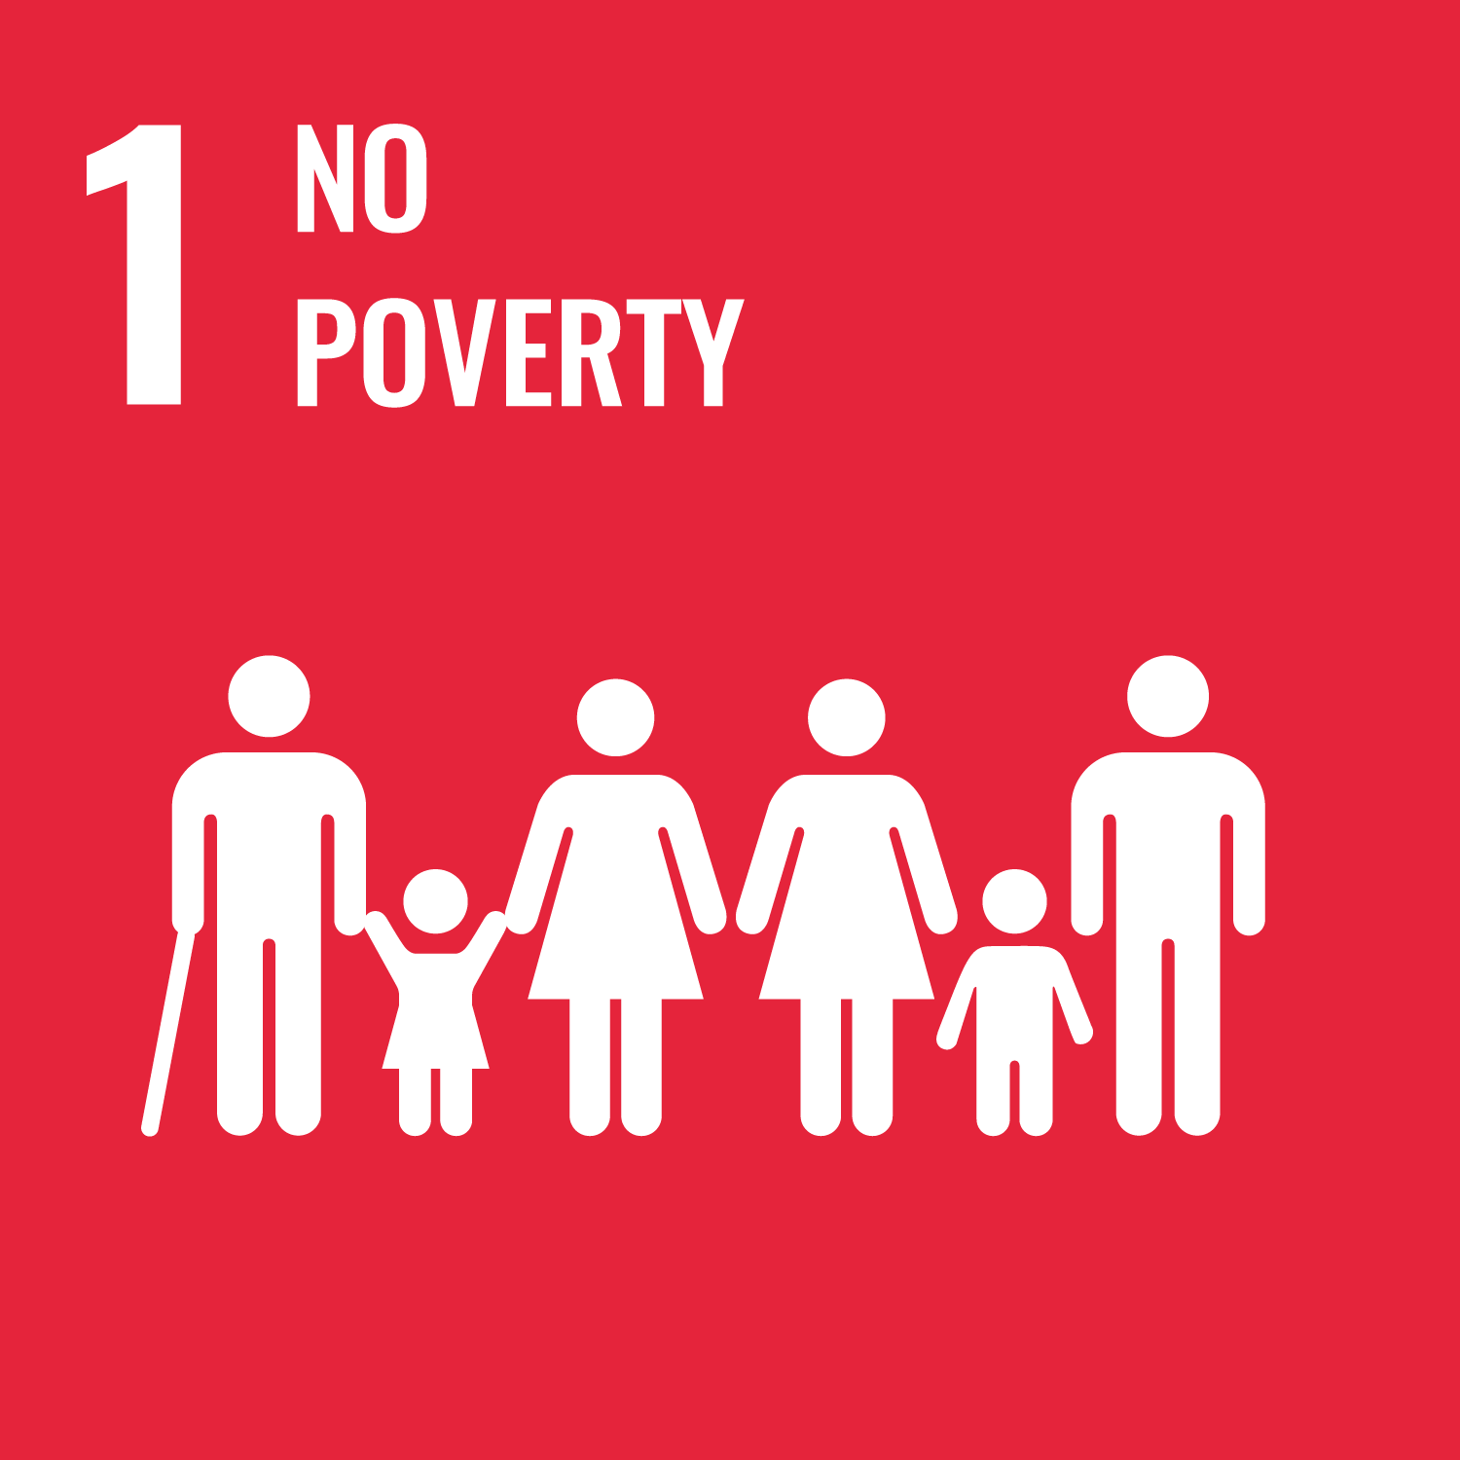

Slide 5
About 10% of the world's people live in extreme poverty, under 1.7 € per day. Many lack adequate nutrition, clean drinking water and sanitation.
In Europe, the poverty line is 60% of national median income. Median income is the amount at which half the population have income above that amount, and half below that amount. Income refers to post-tax disposable income, consisting of employment earnings, investment income, and government social transfers.
The Goal is to:
- eradicate extreme poverty
- reduce by at least by half the proportion of people living in poverty in all its dimensions according to national definitions
- implement nationally appropriate social protection systems and measures for all to achieve substantial coverage of the poor and vulnerable
- ensure that everyone has equal rights to economic resources, access to basic services, ownership of land and property, inheritance, natural resources, appropriate new technology and financial services

Slide 6
What’s the cost? | If you had just 1.7 € / day (about 35 € / month), what would you be able to buy in your country? Estimate how much money a person in your hometown would spend per month on: renting an apartment? - electricity and water? - mobile phone? - eating two times a week at a fast food restaurant? Why is the European poverty line higher than in some other countries?

Slide 7
Good and worrying news For this activity you will need paper and pencils. | Find out how many people live below the poverty line in the world, in your country and in your municipality. What causes poverty? Ten years from today, what good and bad news could there be about poverty. Ask participants to produce one good and one bad newspaper headline about poverty in the future. Participants group the good and bad news headlines together on separate sides of the board or room Participants can vote for the most interesting and most important news headlines in each category. Discuss: how can the good news be realised and the bad news prevented?

Slide 8
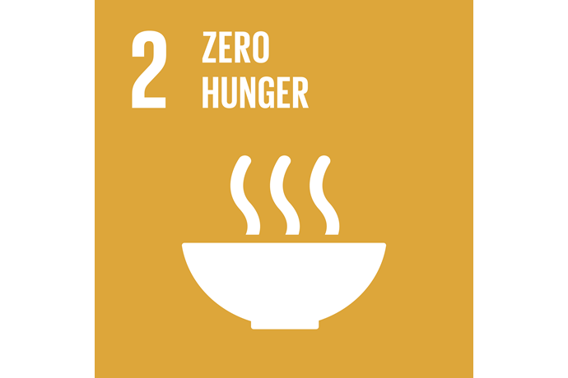

Slide 9
There is enough food produced for everyone in the world. Nevertheless, in 2017, some 815 million people suffered from malnutrition. In addition, 2 billion people would need better quality food because they currently do not get enough, for example, vitamins and trace elements of their food. Long-term hunger and malnutrition cause many times more deaths and morbidity than acute hunger.
The Goal is to:
eliminate all forms of hunger and malnutrition.
achieve food security, which means that everyone in the world will be provided with enough nutritious and safe food.
promote sustainable agriculture
consume, grow and distribute nutritious and safe food without harming the environment.

Slide 10
Nutritious plate For this activity you will need paper and pencils | Consider your meals from yesterday. Share in pictures and by writing: What did you eat yesterday? What did your food look like? How varied was your food? (grains, vegetables, fruit, meat, etc) There may be plenty of food and variety available, but not all food is equally nutritious and sustainably produced. Now assess: How nutritious was your food yesterday? How sustainably produced was your food? Would you make different or more considered choices today?

Slide 11
From farm to table For this activity you will need paper and pencils. | If participants have already completed the nutritious plate activity (see the previous card), return to them. Otherwise, complete that activity first. Participants, individually or in groups, select a product from their nutritious plate activity and examine its production chain. The chain consists of primary production, processing, distribution, trade, consumption and waste, and waste recovery. The participants draw a cartoon, sketch or diagram to explain the product's production chain. Ask the participants to evaluate the sustainability of the production chain. Discuss together.

Slide 12



Slide 13
Six million children die each year before their fifth birthday. 16,000 children die each day from preventable diseases such as measles. In rural areas of the developing world, only 56% of births are done by professionals.
The Goal is to:
- reduces maternal mortality
- prevent the spread of infectious diseases
- reduce premature deaths from non-communicable diseases
- enhance the prevention and treatment of substance abuse.
- halving the number of fatalities and injuries caused by road accidents.
- ensure access to high quality and essential health care for all
- ensure safe, effective, high quality, and affordable essential medicines and vaccinations for all.

Slide 14
conditions of life For this activity you will need paper and pencils. Prepare the following headings for the board / paper: Physical needs Spiritual needs Social needs | Think of children under the age of five. Consider: what kind of needs do they have? Write the needs under the headings: - physical needs - spiritual needs - social needs Which of the things you record are prerequisites for a child to survive? Underline them. One of the Agenda 2030 health and well-being Goals is to reduce the mortality rate of children under the age of five. How could the issues you underlined be addressed in order to reduce infant mortality? Choose an underlined issue, and write a short answer outlining how access to this need can be increased.

Slide 15
Community Immunity For this activity you will need note-making tools. | When a sufficiently large population is vaccinated and resistant to some disease, the disease cannot spread. This also reduces the risk of infection for non-vaccinated individuals. This is called herd immunity. The measles vaccine coverage must be at least 95% in order to achieve herd protection. How many people need to be vaccinated in your country to achieve herd immunity for measles? Which vaccinations are routinely given to people in your country? Discuss: - why don’t all people get vaccinated? - what could be done to increase vaccination rates?

Slide 16



Slide 17
Education is one of the most effective ways of achieving sustainable development, and it is therefore important to guarantee high quality education for all. Currently, 57 million children in developing countries are excluded from education. Worldwide, 103 million young people lack basic literacy skills.
The Goal is to:
enable quality education for all children, regardless of gender and wealth.
ensure free primary and secondary education for all.
ensure affordable vocational training for all.
provide everyone with the knowledge and skills of a global citizens who can promote sustainable development, so that we can build a sustainable future and opportunities together and with respect for human rights.

Slide 18
What if…? For this activity you will need paper and pencils. | Think about what your country would be like in 10 years in the future if... 1. schools no longer had teachers? 2. it cost 10 000 € to attend each school year? 3. only certain genders could attend school?

Slide 19
Educating a global citizenship For this activity you will need paper and pencils. | Part of the quality education Goal is to provide everyone with the knowledge and skills of a global citizen, who can promote sustainable development. In your opinion, - What does it mean to be a global citizen? - What are the most important skills of a global citizen? - Where have you learned these skills? - How should these skills be taught in schools? Participants answer in writing, as a comic strip, or even as video, audio or other art form.

Slide 20



Slide 21
The majority of world's 1.2 billion poorest people are women and girls. Women make up only about 14% of the world's parliamentary members and leaders in industry and government.
The Goal is to:
strengthen the rights and opportunities of women and girls worldwide.
guarantee women's full participation and leadership at all levels of decision-making.
eliminate the unfair division of labor of unpaid care and domestic work
end discrimination against women in public decision-making.
stop violence and harmful practices such as child marriages and forced marriages, and female genital mutilation.

Slide 22
Cover stories For this activity you will need paper and coloured pencils. | Choose randomly five magazine covers. Evaluate who you think the magazine is targeted to? On what basis did you decide that? (choices of words, colours, fonts, pictures, topics, etc) Create a cover for a new gender inclusive magazine. What name would you give to your magazine? What kind of pictures could be on the cover? What kind of headlines could support the Goal of increasing gender equality?

Slide 23
High five For this activity you will need paper and pencils. | Participants are handed sheets of paper and asked to trace the outlines of both of their hands. Participants are asked to fill out one hand for girls / women and the other hand for boys / men according to the following points of view or gender stereotypes: Little finger: Colours Ring finger: Professions Middle finger: Housework Pointer finger: Hobbies Thumb: Features or strengths Display all the hands, and ask the participants to express which hands they think belong to which gender. Discuss how difficult or easy it was to identify this, and why so? In the palm of each hand, ask the participants to add problems that may be caused by, and things that may be overlooked on the basis of, gender (e.g. "boys will be boys", “that’s for girls”, etc).

Slide 24



Slide 25
Lack of clean water affects more than 40% of the world's population. Every continent suffers from a lack of sufficient and safe drinking water. By 2050, it is predicted that at least one in four people will suffer from chronic water shortages.
The Goal is to:
guarantee safe and affordable access to safe drinking water, and adequate sanitation and hygiene for all.
end open toilets, paying particular attention to the needs of women and girls and the disadvantaged.
improve water quality by reducing pollution eg. closing landfills and minimizing emissions of hazardous chemicals and materials.
protect and restore water-related ecosystems such as mountains, forests, wetlands, rivers, groundwater and lakes.

Slide 26
Toilet or texts? For this activity you will need paper and pencils. | One third of the world's people do not have access to a toilet. More people in the world have access to a cell phone than a toilet. Select one of the following topics and write freely for 5 minutes. A) How would your life be different without tap water? B) Which one is more important to you: a cell phone or a toilet, and why?

Slide 27
Tippy Tap For this activity you will need a hand-basin, plug, soap, a device with a network connection to watch the video, and a selection of materials for building a tippy tap (eg. water canister, string, soap bar, sticks) It is good to wash your hands repeatedly throughout the day, but especially: Before eating or cooking food After touching raw food (especially meat such as chicken) After using the toilet After touching animals After touching rubbish After changing a baby's diaper After coughing, sneezing, or blowing your nose Before and after dressing a wound. More information on clean hands can be found at www.who.int/gpsc/clean_hands_protection/en/ | There are places in the world where every bucket of water used means a new journey to the well. This takes time away from eg. school. However, washing your hands with soap reduces the number of deaths caused by diarrhea by more than 40%. Therefore, water-saving solutions like tippy tap are needed. Close the sink with a plug and measure how much water it takes to wash your hands. Washing your hands should last about 20 seconds. Consider when you would need to wash your hands. Estimate how many times in total your family washes their hands throughout the day. How many litres of water does this take? Watch a video of the tippy tap at: www.tippytap.org/videos. Try building your own tippy tap.

Slide 28



Slide 29
13% of the global population still lacks access to modern electricity. 3 billion people rely on wood, coal, charcoal or animal waste for cooking and heating. Energy is the dominant contributor to climate change, accounting for around 60 per cent of total global greenhouse gas emissions. Affordable and clean energy solutions play a key role in combating climate change. As energy demand grows, renewable energy sources are needed to play a crucial role.
The Goal is to:
provide affordable, reliable and modern energy services for all.
substantially increase the share of renewable energy as an energy source. Renewable energy is, for example, electricity produced by solar, wind and hydropower plants.
double the rate of energy efficiency, ie saving energy.

Slide 30
Time capsule from the past For this activity you will need pens and paper. | A time capsule is used to deliver messages to the future. It is usually an airtight container that holds texts and objects intended for the time capsule openers. The time at which it can be opened may be defined on the capsule itself. Imagine you found a time capsule from 1920. Write answers to the questions: - Who built the time capsule? - What items does it contain? - What energy sources would have been needed to produce these items? - What does this tell us about how the world has changed since 1920?

Slide 31
Time capsule For this activity you will need pens and paper. | A time capsule is used to deliver messages to the future. It is usually an airtight container that holds texts and objects intended for the time capsule openers of the future. The time at which it can be opened may be defined on the capsule. Design a time capsule with a message: this is how we lived and produced energy! What would you put in the time capsule? What would each object or text explain? How would you communicate the concepts of renewable energy and energy efficiency? Where would the time capsule be hidden? When can it be opened?

Slide 32



Slide 33
As the world economy recovers from the effects of crisis, growth has slowed, injustices have increased and labour markets struggle to meet the demands of a growing workforce. The global unemployment rate is 5.7%, and having a job doesn’t guarantee the ability to escape from poverty in many places. This slow and uneven progress requires us to rethink and retool economic and social policies aimed at eradicating poverty, to ensure that everyone shares in the progress.
The Goal is to:
Achieve full and productive employment and decent work for all, including young people and people with disabilities
Achieve equal pay for work of equal value.
Promote practices that support entrepreneurship, creativity and innovation.
Stop forced labor and human trafficking.
To stop child labor in all its forms, particularly the use of child soldiers.
Protect labor rights and ensure a safe working environment for all workers, especially women and those in precarious employment.

Slide 34
Decent Work Alphabet For this activity you will need pencils. Also, on a large sheet of paper or whiteboard, write the title "Decent Work Alphabet" and the letters of the alphabet. | Write down points of view you think are related to decent work. Group the issues together under each letter of the alphabet. Several things can be written under the same letter. E.g. S for safety E for equal pay

Slide 35
Weather vane Statements to be used in this activity: - In our country, everyone receives equal pay for equal work. - Entrepreneurship seems like an attractive career option. - I can influence the cessation of child labor. - Women and men are equal in working life. - Insecure employment will be a normal situation in the future. | 1) Mark one wall in the space to indicate 'agree'. Mark the opposite wall to indicate 'disagree'. 2) The participants stand up and take a position on each statement made. An opinion is expressed by turning towards the wall matching the opinion. Intermediate positions are also allowed, by turning part way in each direction. 3) After everyone has turned, a joint discussion begins with reasoning to specify the direction of the turn. If the reasoning causes the other participants to change their minds or update their position, they can turn in the direction reflecting the change in opinion.

Slide 36



Slide 37
Infrastructure like roads, information and communication technologies, sanitation, electricity and water remains scarce in many countries. Over 4 billion people live without Internet, 90% of whom are in developing countries. Infrastructure investment is necessary for sustainable development. Technological progress is crucial to reaching environmental objectives, such as increased resource and energy-efficiency.
The Goal is to:
Develop quality, reliable infrastructure to support economic development and human well-being, focussing on affordable and equitable access.
Promote inclusive and sustainable industrialization and increase industry's share of employment.
Enhance resource efficiency and uptake of environmentally-friendly technologies
Provide equal and affordable access to the Internet.
Enhance scientific research, encourage innovation and increase research and development
Support developing countries' own technological development, research and innovation.

Slide 38
Invention interventions! For this activity you will need pencils and paper. | Many inventions and innovations have been developed to address social, cultural, economic and environmental challenges. If you were to present contemporary inventions or innovations that make our lives easier and solve some of the problems of sustainable development to the people in the 22nd century, which ones would you choose? The inventions can be tangible or intangible (e.g. solar panels, gore-tex fabric, online services). Illustrate and describe the invention! What makes it a useful innovation or invention? Describe it in a way that enables the future people to understand what it is all about.

Slide 39
Map of interdependence For this activity you will need printed maps of interdependence, as well as a device with network connection to watch a video. The video is based on the essay “I, Pencil” by Leonard E. Read, who claims that it is unlikely that anyone would truly know the whole story of a pencil. The essay is also freely available to read online. Maps of interdependence: bit.ly/agendacards9-1 Video of the pencil journey: bit.ly/agendacards9-2 | Watch the video of the journey of a pencil. Form small groups and choose a product you are familiar with, such as a cell phone, pair of jeans, or tooth brush. Fill in maps of interdependence: what resources, labour, infrastructure and industrial solutions are required to make the item you chose? Consider the global pros and cons: - Are there any factors in the maps that could be improved? - What would happen if you changed a factor on the map, such as removing cheap labor? - What effect would the change have on the production process and the people who make it?

Slide 40

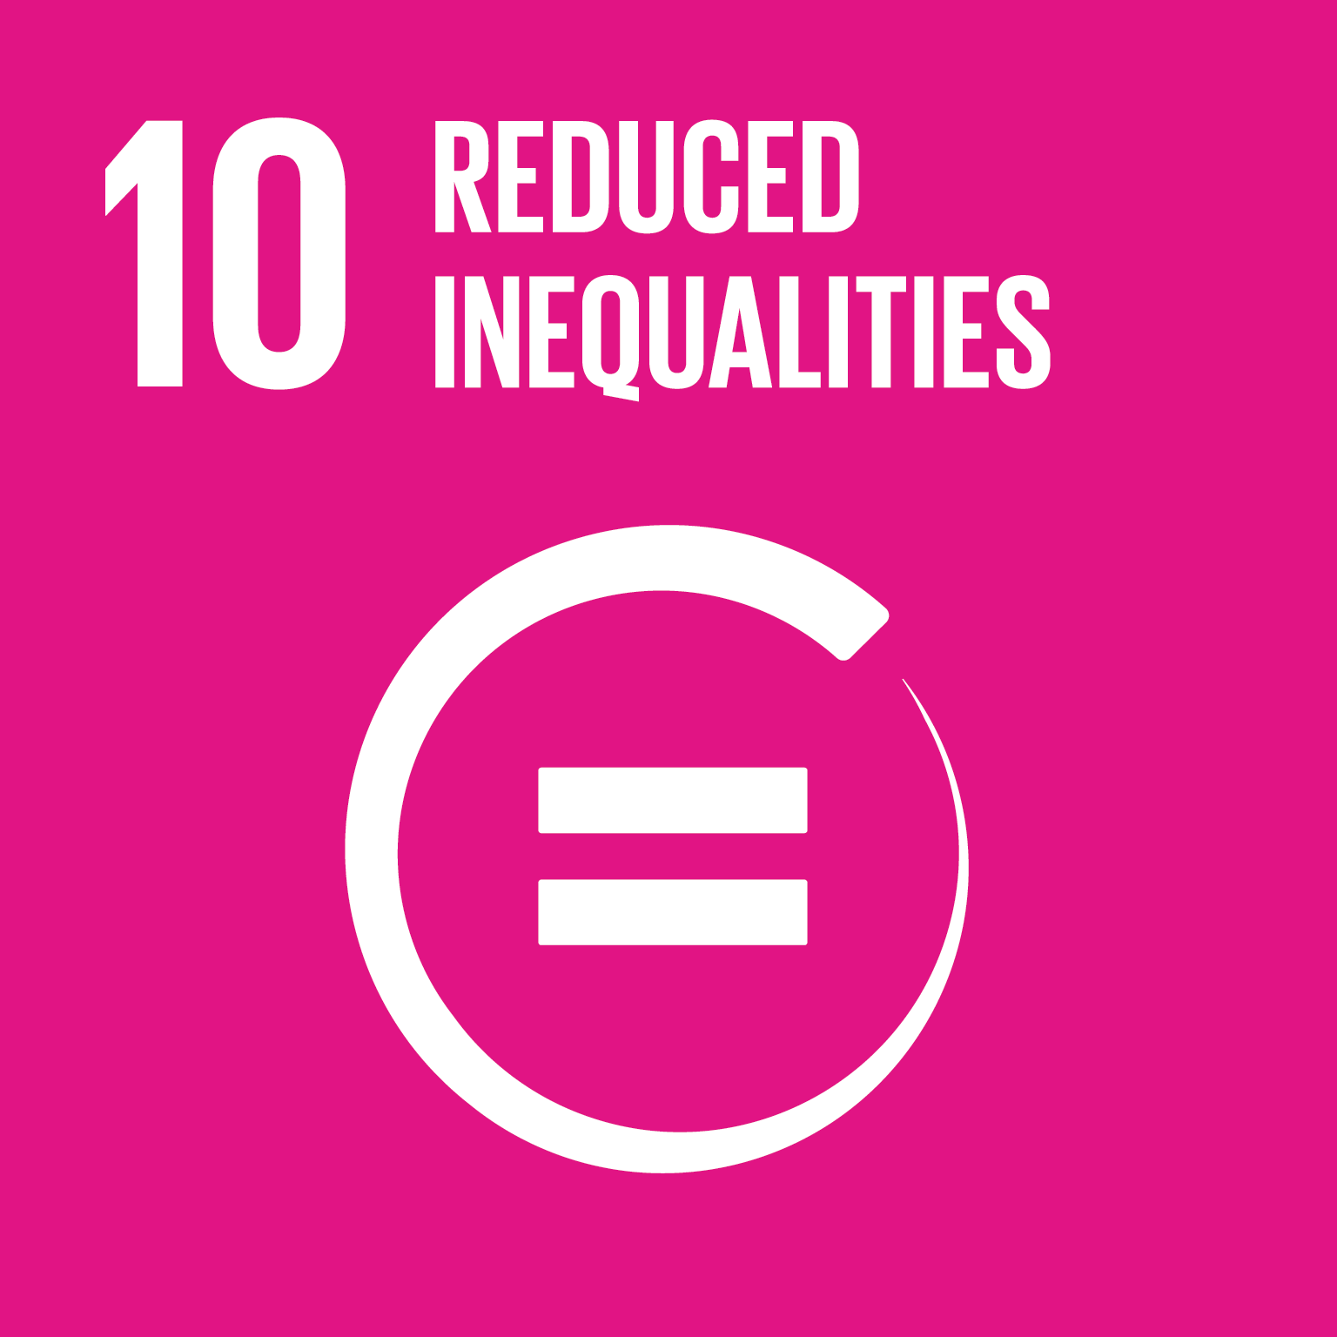

Slide 41
Inequality in society has many different dimensions, in income differences, health, education, exclusion, experiences of well-being and life satisfaction. The dimensions of inequality are strongly interconnected and impact on social peace.
Although progress has been made towards lifting people out of poverty, disparities remain in access to health and education services and other assets.
The Goal is to:
promote the social, economic and political inclusion of all, irrespective of age, sex, disability, race, ethnicity, origin, religion or economic or other status
ensure equal opportunity and reduce inequalities of outcome
ensure enhanced representation for developing countries in decision-making in international economic and financial institutions to deliver more accountable and legitimate institutions
facilitate orderly, safe and responsible migration and mobility of people
improve targeting of development aid and direct investment in areas of greatest need.

Slide 42
Agree or disagree? For this activity you will need pencils and paper. | Answer the following statements (agree or disagree?) Immigrants can easily integrate into our society. In our country, economic well-being does not affect overall well-being. A person’s race, ethnicity, or religion can have a significant impact on employment prospects in our country. Inequality does not have an impact on social peace in our country. Accessibility for people with reduced mobility is almost always well implemented in our country. Please select one of the questions above and justify your answer.

Slide 43
Enemies of Inequality For this activity you will need pencils and paper. | 1. Discuss: - What findings of inequality have you made recently (eg at school, in hobbies, at home, in the city, in the news)? - What could be the reasons for the inequalities you see (eg gender, age, religion, wealth, disability)? 2. Reflecting on their own personal strengths, each participant will create a superhero figure in the fight against inequality. Participants will come up with a name, specify a super power, and draw a picture of their super hero in action. 3. Participants will design a common archenemy and a combat plan to fight it that utilizes elements of each participants' superpowers.

Slide 44



Slide 45
Cities are hubs for ideas, commerce, culture, science, productivity, social development and much more. Cities have enabled people to advance socially and economically. The majority of the world's population lives in cities and the number is growing. It’s important that efficient urban planning and management can deal with the challenges of urbanization.
The Goal is to:
ensure access for all to safe and affordable housing and basic services
provide access to safe, affordable and accessible transport systems
enhance inclusive and sustainable planning and management
of urbanization
intensify projects to protect the world's cultural and natural heritage
support positive economic, social and environmental links between urban, peri-urban and rural areas by supporting national and regional development plans
provide universal access to safe and inclusive green and public spaces, in particular for women and children, older persons and persons with disabilities.

Slide 46
Happy mapping For this activity you will need maps of your local area, online or printed. | Explore an area on the map where you usually move around during your free time. Reflect: Which locations in the area make you feel happiest? Which locations do you find uncomfortable or unsafe? Which locations are easy to navigate? Which are difficult to navigate?

Slide 47
Mapping together For this activity you will need note-taking tools, pencils in two different colours, and printed maps of the surrounding area. | Participants interview an agreed number of people that spend time in the surrounding area. Participants ask interviewees the following questions: Which location in this area makes you feel happiest? Which location in this area do you find uncomfortable or unsafe? Participants take notes of the answers, and mark the locations on the map, happy in the first colour and unsafe in the second colour. The results obtained are transferred to a shared class map and the results are discussed. How can these locations be made safe, inclusive and accessible for all?

Slide 48



Slide 49
Sustainable consumption and production promotes resource and energy efficiency and a better quality of life for all. It helps to reduce future economic, environmental and social costs. At the current time, material consumption of natural resources is increasing. Countries continue to address air, water and soil pollution challenges.
The Goal is to:
achieve sustainable and efficient use of natural resources
halve the global level of food waste at the retail and consumer level and reduce food waste in the production and distribution chains.
ensure environmentally sound management of chemicals and waste
reduce waste generation through prevention, recycling and reuse.
encourage large and international companies in particular to adopt sustainable practices
support developing countries to strengthen their scientific and technological capacities to move towards more sustainable consumption and production
rationalize inefficient and wasteful subsidies for fossil fuels

Slide 50
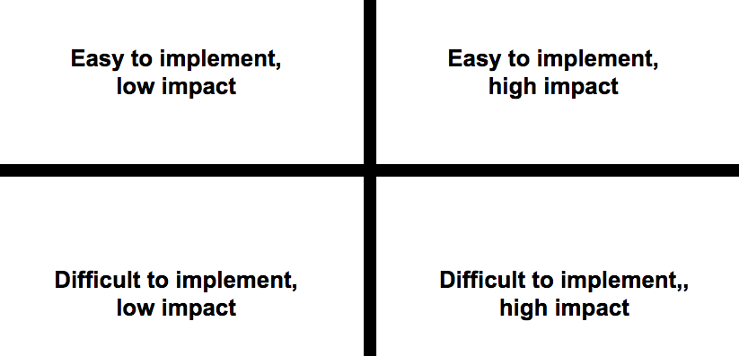
Idea grid for responsible consumption For this activity you will need sticky notes and pencils. Prepare a grid according to the picture, for example, on a large sheet of paper or whiteboard. | 1) Brainstorm different ways to achieve more responsible consumption. Ideas can be related to, for example, local tourism, recycling and reuse, efficient use of natural resources, or food waste. Each idea is written on a separate sticky note. 2) Place the ideas in the grid according to whether you think the idea is easy / difficult to implement, and whether the idea has a high / low impact.

Slide 51
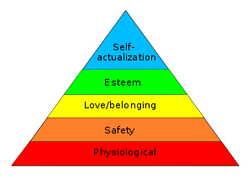
Essential choices For this activity you will need sticky notes and pencils. Also, prepare Maslow’s hierarchy of needs pyramid on a whiteboard. | There are people in the world who live in extreme poverty, on less than 2 € per day. Form small groups and reflect on which essential items your families must spend money on. Write each item on a separate sticky note. Each group brings their sticky notes to the common wall. The facilitator groups similar tags on top of each other. How many different essential items are there? Which do you think are the most essential or important? Rank these essential items according to a hierarchy of needs pyramid.

Slide 52



Slide 53
Climate change affects every country on every continent. It disrupts national economies and affects lives. Weather patterns are changing, sea levels are rising, weather events are becoming more extreme and greenhouse gas emissions are now at their highest levels in history. Without action, the world’s average surface temperature is likely to increase 3°C this century. The poorest and most vulnerable people are affected the most.
The Goal is to:
strengthen adaptive capacity to climate-related hazards and natural disasters
integrate climate change measures into national policies and planning
improve human and institutional capacity on climate change mitigation, adaptation, impact reduction and early warning
mobilize $100 billion a year from developed countries for mitigation actions to address the needs of developing countries
Promote effective climate change-related planning and management in least developed countries and small island developing States

Slide 54
Sacrifice? For this activity you will need pencils and printed segment templates you can find at bit.ly/agendacards13. | Mark down on the scale how easy it would be for you to give up the following things. single-use plastic bags traveling by plane ordering products from abroad meat products traveling by private car imported fruits fast fashion Choose a further two things to consider giving up for climate action, and mark down on the scale how easy it would be for you to give up each. Which category would be the easiest to give up? Which category would be the hardest to go without?

Slide 55
Action to Achieve For this activity you will need pencils, paper and equipment to design your own climate action. | Consider the following climate actions: climate strikes gasoline tax planting trees vegetarian days in schools boycott all air travel To what extent can each of these climate actions achieve the desired results? Can they be realistically implemented? Design 5 climate actions for your daily life that you believe you could commit to.

Slide 56

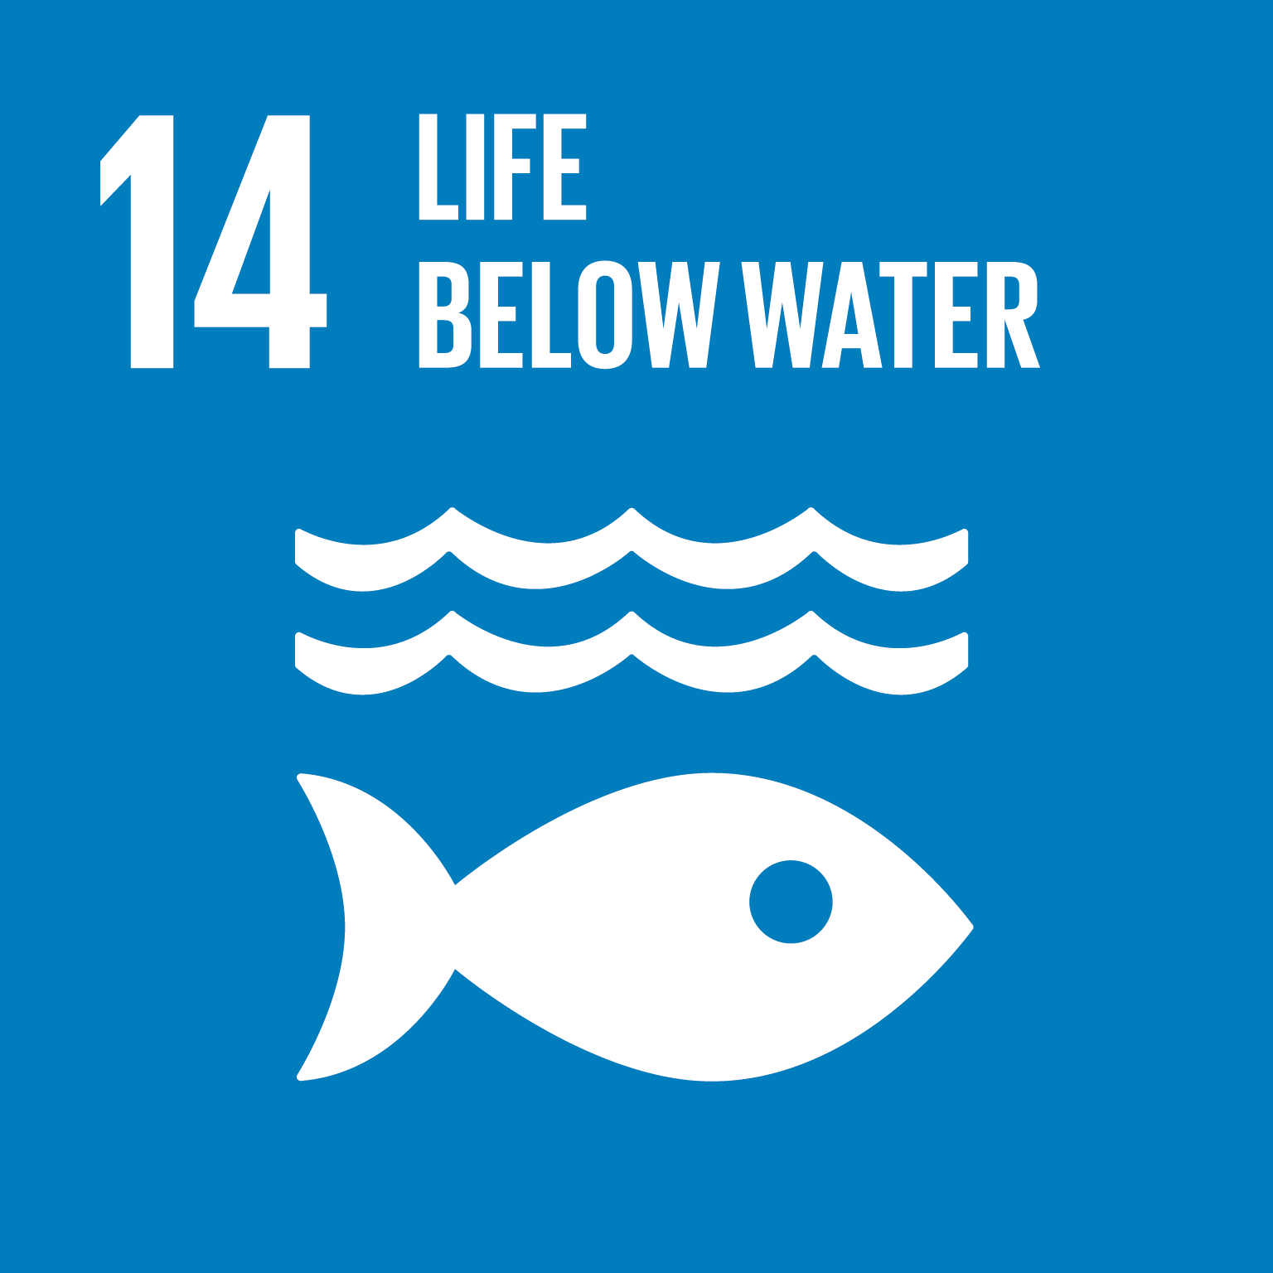

Slide 57
The state of the seas and biodiversity of coastal ecosystems are particularly affected by overfishing, climate change, pollution and coastal eutrophication. Eutrophication of watercourses, due to the discharge of fertilizers from agriculture and untreated wastewater, causes water clouding, proliferation of aquatic plants and overgrowth of watercourses. It is estimated that, without preventive measures, 20% of large marine ecosystems will suffer from eutrophication in 2050.
The Goal is to:
prevent and significantly reduce marine pollution of all kinds, particularly from land-based activities, like marine debris and nutrient pollution
sustainably manage and protect marine and coastal ecosystems to avoid adverse impacts to achieve healthy and productive oceans
effectively regulate harvesting and end overfishing, illegal, unreported and unregulated fishing and destructive fishing practices
enhance the conservation and sustainable use of oceans and their resources

Slide 58
Plastic travel For this activity you will need pencils and paper. Prepare headings on the board - Rubbish bin - Recycling point - Elsewhere | Most plastic waste ends up in landfill, from which it can leak pollution into the soil and waterways. Plastic waste left on the ground often ends up in streams and rivers. About 8 million tonnes of plastic enter the sea each year. It is estimated that by 2050 the ocean will contain more plastic than fish. Think of 5 products you use that contain plastic. Place your 5 products under the headings rubbish bin, recycling point, and elsewhere, according to where you discard them. Consider whether non-plastic alternatives are available. Next to each plastic product, place an alternative (eg metal straws, bamboo toothbrushes).

Slide 59
Under the surface For this activity you will need paper, crayons, magazines, scissors and sticky tape. | Read the short story below for the participants: You have all gained the ability to breathe underwater and have spent the day travelling with a whale. You all marvel at the wonders and beautiful things in the ocean. However, the whale is somewhat less happy. Life underwater today does not look the same as in the past. What might be wrong? Create an underwater view of problems that the whale may observe. Create another image that shows what can be done to improve the situation.

Slide 60

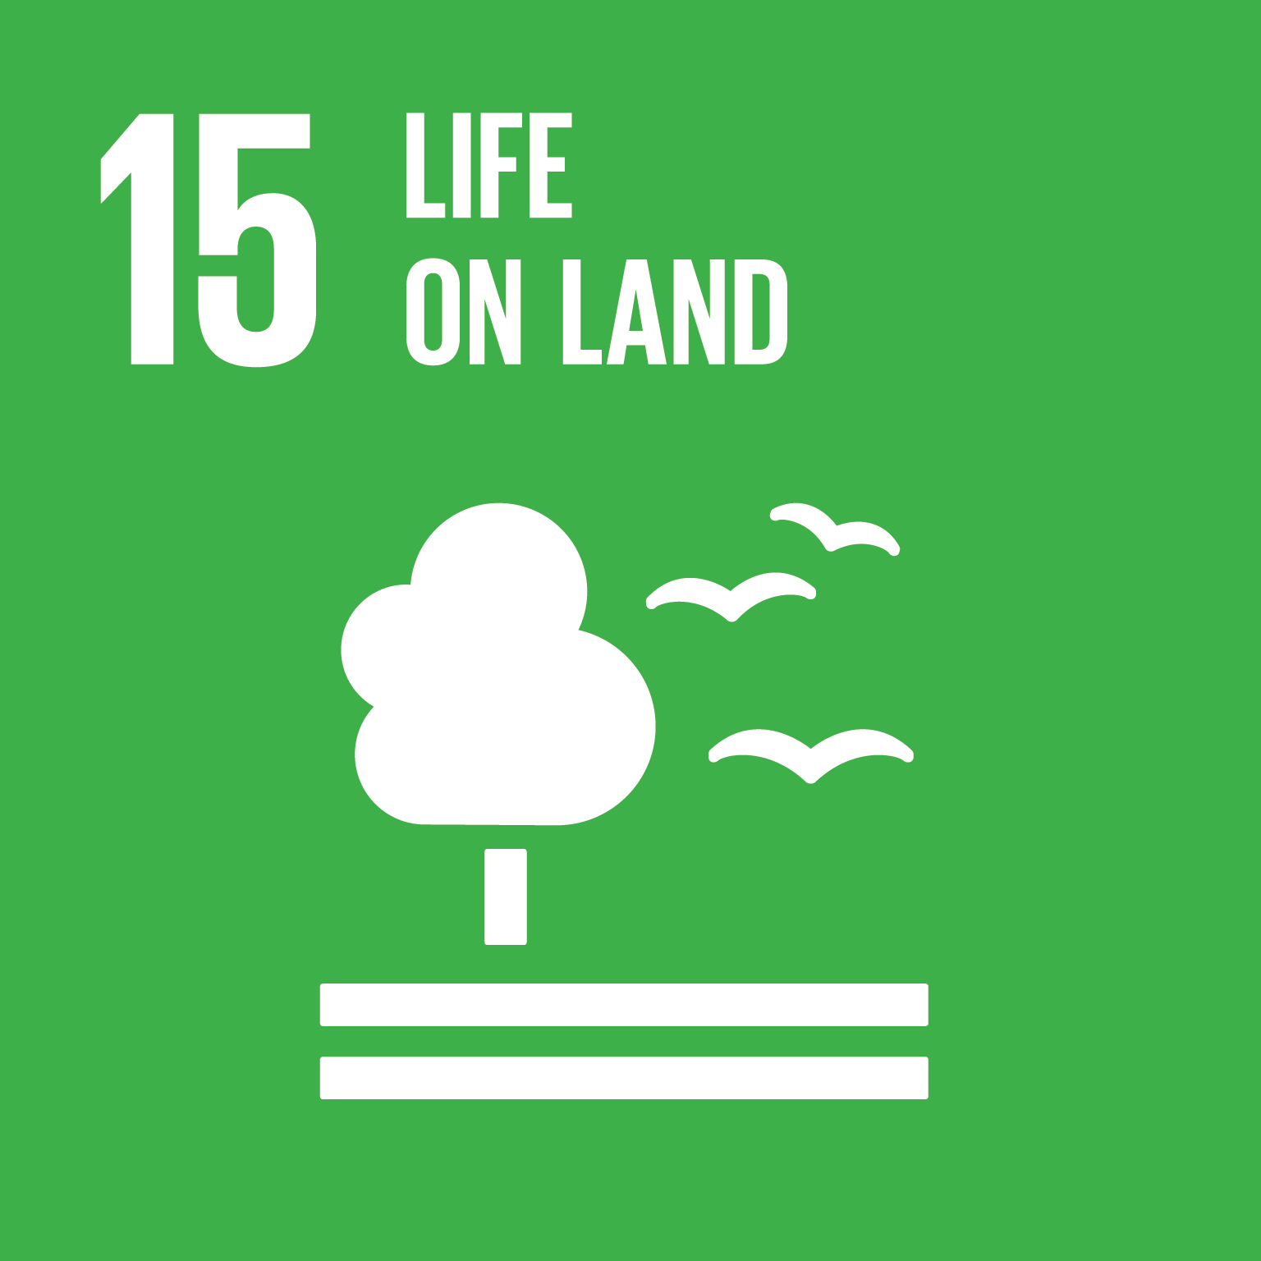

Slide 61
Biodiversity is declining at an alarming rate. Coral reefs are in danger of disappearing completely by 2050. Many species of plants and animals are at risk of disappearing as habitat biodiversity is lost, or by poaching and trade in animal parts and plants.
The Goal is to
ensure the conservation, restoration and sustainable use of terrestrial and inland freshwater ecosystems, particularly forests, wetlands, mountains and drylands
implement sustainable management of forests, halt deforestation, restore degraded forests and increase afforestation and reforestation
combat desertification, restore degraded land and soil, affected by desertification, drought and floods, and strive to achieve degradation-neutral land
take urgent and significant action to reduce degradation of natural habitats, halt the loss of biodiversity and, protect and prevent the extinction of threatened species
enhance global efforts to combat poaching and trafficking of protected species

Slide 62
Endangered animals For this activity you will need paper, pencils and device with network connection. | Choose an endangered animal. Answer the following questions: - what ecosystem does the live in? - what are the threats to the animal’s conservation? - what actions are being taken to protect the species? - is the situation improving? why or why not? - what further actions could be taken to protect the species? Did any of the answers surprise you?

Slide 63
Organisms and ecosystems For this activity you will need a network connection, pens and paper. | Terrestrial life includes many different ecosystems, including forests, swamps, coral reefs, jungles, deserts, plains, and mountains. Participants form small groups based on different ecosystems Work together to answer the following questions: What are the biggest threats to your ecosystem? Which plants and animals are most at risk? Which Agenda 2030 Life on Land sub-Goals are most relevant to protecting your ecosystem? Prepare a short quiz about your ecosystem for the other groups to answer.

Slide 64



Slide 65
The threats of international homicide, violence against children, human trafficking and sexual violence are important to address to promote peaceful and inclusive societies for sustainable development. Access to justice for all and building effective, accountable institutions at all levels are needed.
Some countries enjoy lasting peace and prosperity, while others suffer amid cycles of violence and conflict. The number of wars has increased by 25% since the 1950s, but the number of deaths in conflicts has fallen significantly.
The Goal is to:
significantly reduce all forms of violence and related deaths
stop all child abuse, exploitation, trafficking in human beings and all forms of violence and torture
reduce corruption, develop accountable and transparent institutions at all levels, ensure flexible and inclusive decision-making, guarantee public access to information and safeguard everyone's fundamental freedoms
promote and enforce anti-discrimination laws

Slide 66
Traffic lights For this activity you will need pencils and printable traffic lights you can find at bit.ly/agendacards16. | In order to achieve the Goal of peace and justice, consider which ideas, attitudes, actions, and laws should be: - Stopped or overturned - Further developed - Started as new Consider: - Why do you think the red light topics have not ended already? - To what extent are changes in the yellow light topics occurring fast enough? - Why hasn’t progress been made on the green light topics?

Slide 67
Peace profile For this activity you will need paper and pencils. | List 10 individual-level qualities and 10 state-level characteristics that promote peace and justice. List reasons why each feature may not materialize. What may prevent this peace-promoting feature? Create ideal images of a person and a state that each promote the principles of peace and justice. These images can also be illustrated with drawings. Discuss what actions we can take to get closer to reaching these ideals.

Slide 68



Slide 69
A successful sustainable development agenda requires partnerships between governments, the private sector and civil society. These inclusive partnerships built upon principles and values, a shared vision, and shared goals that place people and the planet at the centre, are needed at the global, regional, national and local level.
The Goal is to:
strengthen domestic resource mobilization, including through international support to developing countries, to improve domestic capacity for tax and other revenue collection
raise development finance for the least developed countries to alleviate poverty. The richest countries should support developing countries
support sustainable development, global cooperation and global partnerships.
support the implementation of sustainable development through finance, technology, capacity building, fair trade development and addressing systemic issues.
encourage all the different actors in society work together to achieve the goals.

Slide 70
Influencing rocks For this activity you will need paper, scissors, pens and sticky tape. | Cut three rock shapes from the paper. To influence the realization of the Agenda 2030 Goals: - What can you do? - What can your school do? - What can your country do? Write an answer for each of the questions on a paper rock. Form together a collective pile of influencing rocks. When placing a rock to the pile, consider whether it is the foundation for other rocks, or if it builds upon the previous rocks.

Slide 71
Six hats This is a role-playing game developed by Edward De Bono, in which each participant represents a defined perspective, i.e. colour. For this activity you will need printed role descriptions that can be found at: bit.ly/agendacards17 | Start by completing the influencing rocks activity. The facilitator divides the participants into small groups. Each group chooses one of the influencing rocks. The group discusses the topic or matter of the rock from the perspective of different coloured hats. All group members share the same colour at the same time, so everyone has the same perspective on the conversation. Once the group has discussed the matter with all 6 different hat perspectives, they can choose another influencing rock topic.

