Slide 1
MAORI

Slide 2
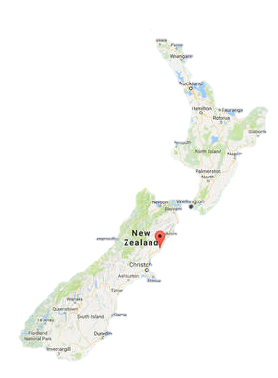
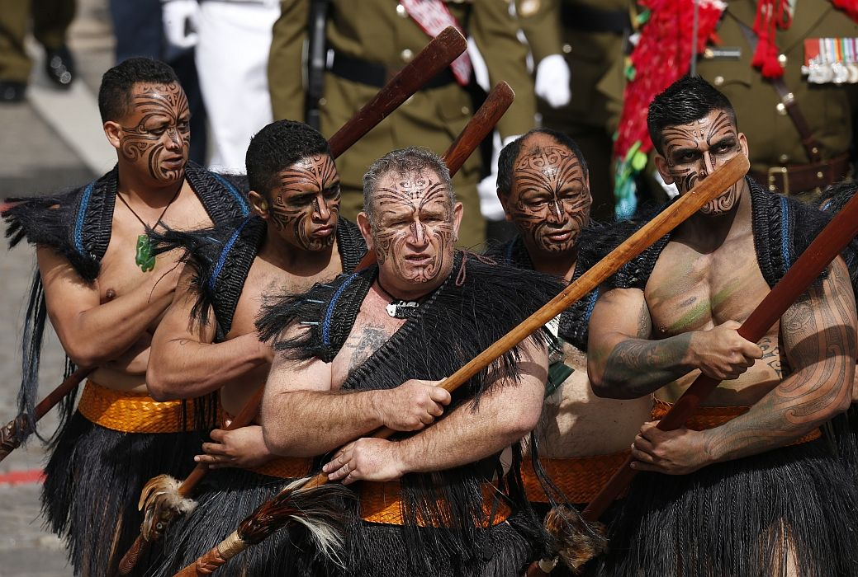
ZGODOVINA IN SEDANJOST

Slide 3
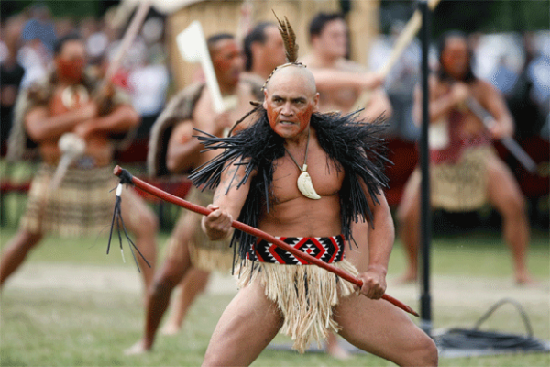
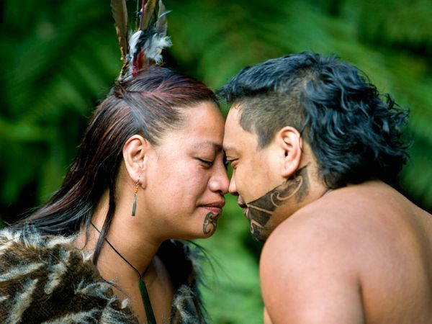
OBIČAJI

Slide 4
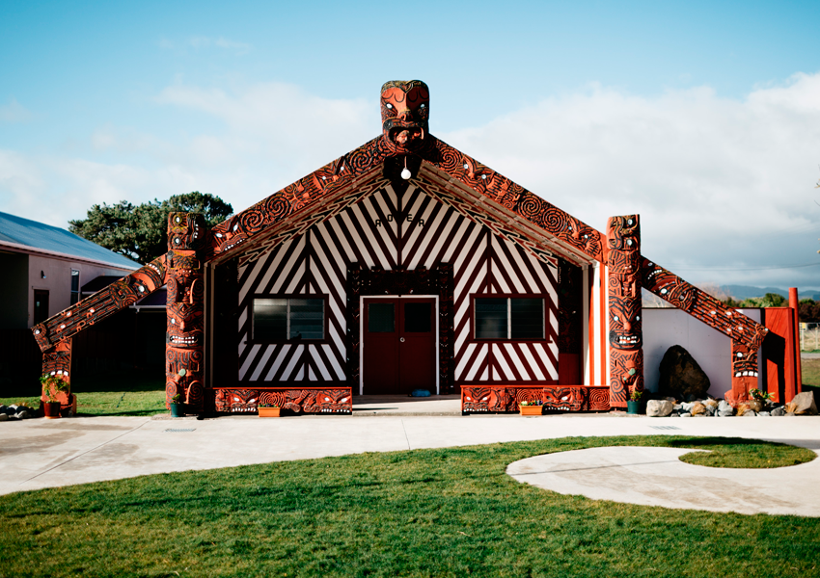
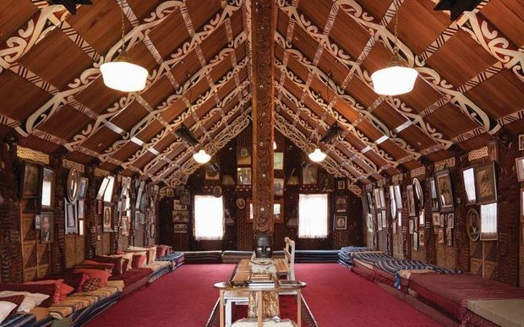
MARAE

Slide 5
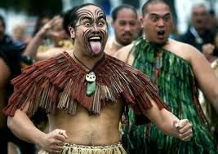
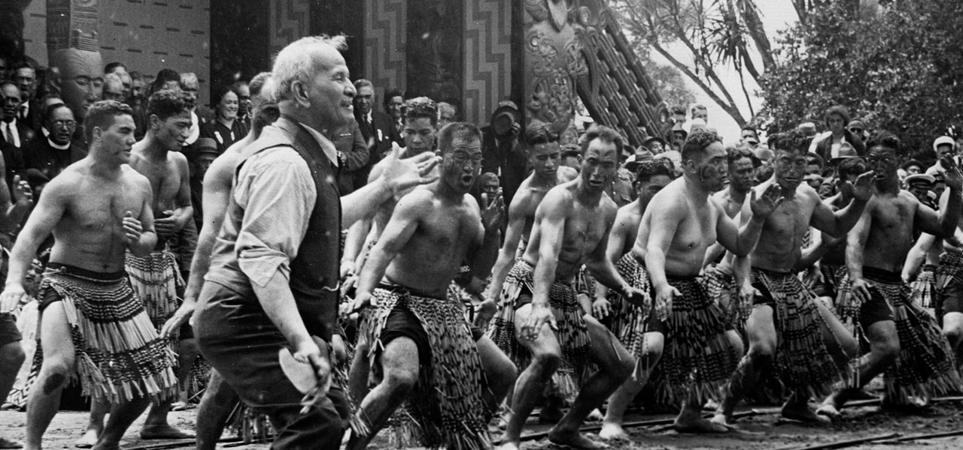
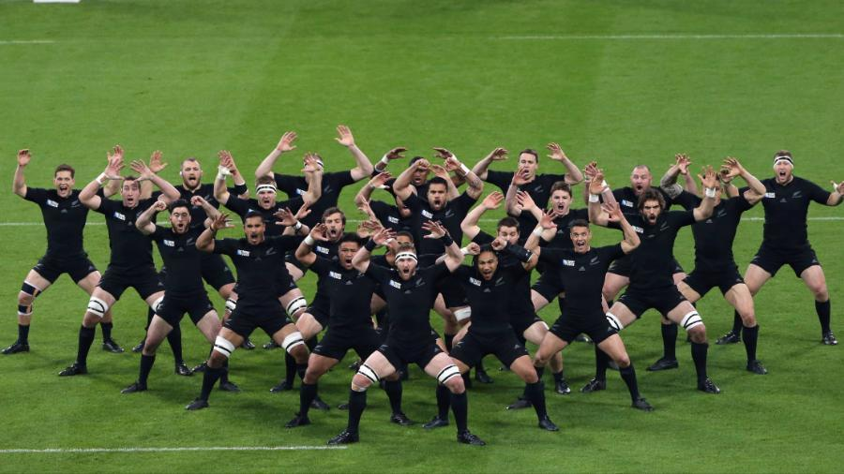
PLES
https://www.youtube.com/watch?v=BI851yJUQQw
https://www.youtube.com/watch?v=hn8Xx2646Mw
https://www.youtube.com/watch?v=yiKFYTFJ_kw

Slide 6
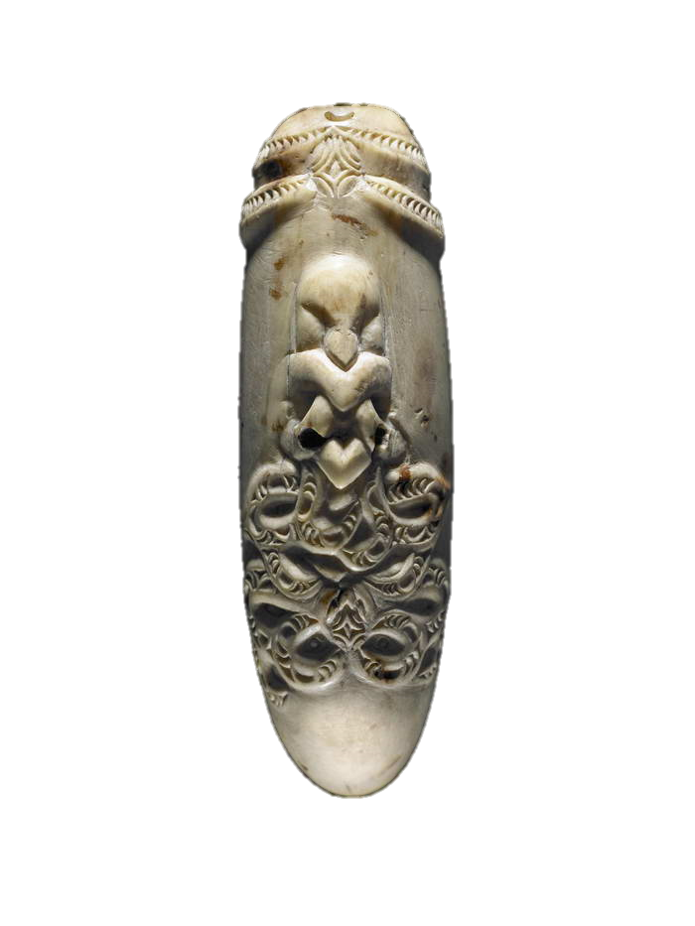
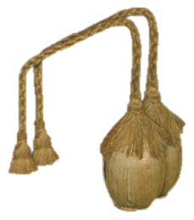
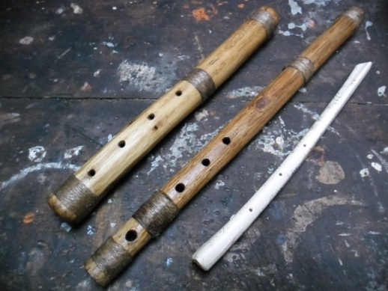
GLASBA
Glasbilo Poi
Glasbilo Nguru
Glasbila Porutu
https://www.youtube.com/watch?v=PzBWyc48YOc

Slide 7
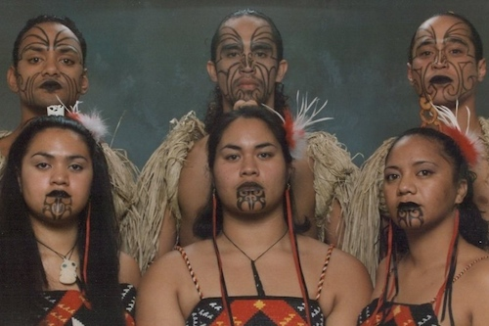
MAORSKE TETOVAŽE

Slide 8
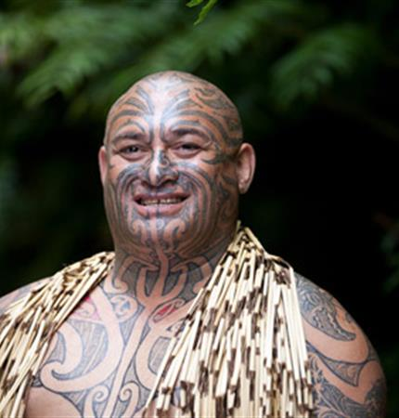
KONEC

