Slide 1
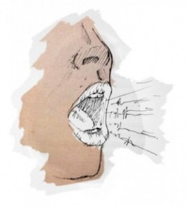
UPEVANJE
https://www.youtube.com/watch?v=tnJW-8a26OA
Brnenje z ustnicami
Majmajmajmajmaj
I sight to see
Johohohoho
Ma me mi mo mu

Slide 2
WE ARE THE WORLD
Marca leta 1985 so znani pevci Lionel Richie, Michael Jackson, Cyndi Lauper, Kenny Rogers, Diana Ross in več kot 40 drugih priznanih glasbenikov skupaj zapeli pesem We are the World, ki je nato postala nekakšna himna. Vzrok za nastanek pesmi je bila afriška lakota. Besede, kot so: "Nimamo možnosti izbire, moramo rešiti svoja življenja," so tako postale del združujoče legendarne himne. Zaradi pandemije koronavirusa in 35. obletnice izdaje uspešnice je Lionel prepričan, da je sedaj pravi čas, da znova zapojejo pesem, ki jo je napisal skupaj s pokojnim Jacksonom.

Slide 3
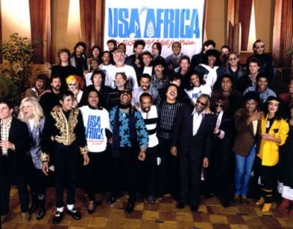
NAJSTAREJŠA IZVEDBA
https://www.youtube.com/watch?v=M9BNoNFKCBI

Slide 4
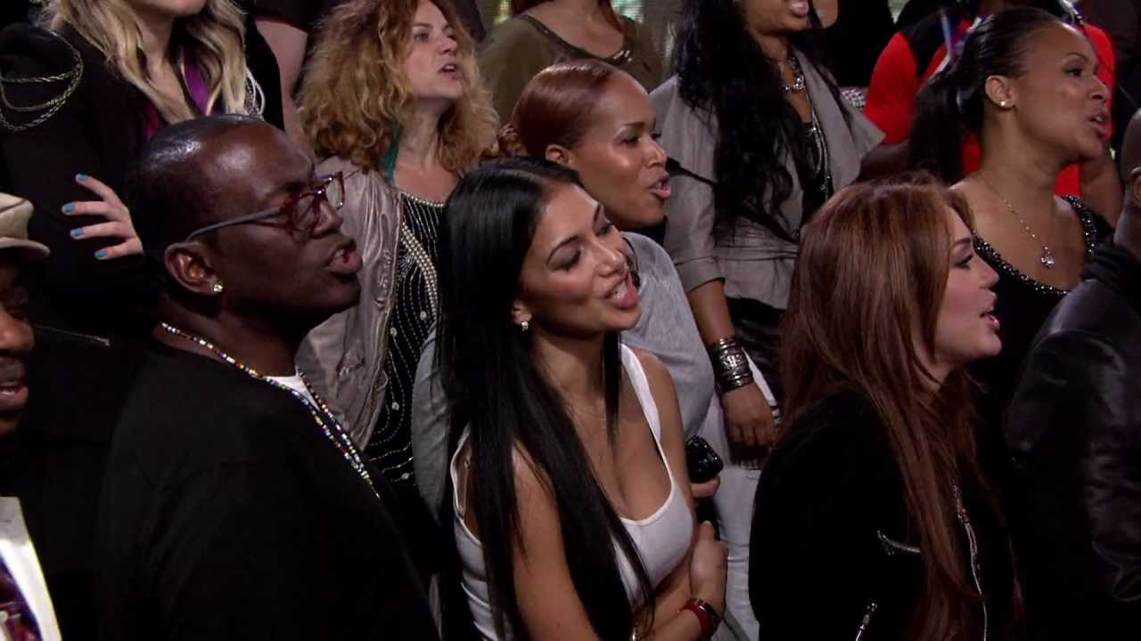
DRUGA IZVEDBA
https://www.youtube.com/watch?v=Glny4jSciVI
Lionel Richi je pred 10 leti novo verzijo ikonične pesmi posvetil žrtvam potresa na Haitiju. To verzijo izvajajo najverjetneje vam bolj poznani glasbeniki.

Slide 5
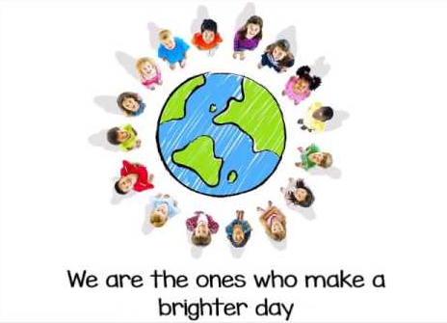
IZVEDBA MLADINSKEGA PEVSKEGA ZBORA
https://www.youtube.com/watch?v=LY0v0MaZ2fQ

Slide 6
BESEDILO
There comes a time
When we heed a certain call
When the world must come together as one
There are people dying
Oh, and it's time to lend a hand to life
The greatest gift of all
We can't go on
Pretending day-by-day
That someone, somewhere soon make a change
We're all a part of God's great big family
And the truth, you know, love is all we need
We are the world
We are the children
We are the ones who make a brighter day, so let's start giving
There's a choice we're making
We're saving our own lives
It's true we'll make a better day, just you and me
Oh, send them your heart
So they know that someone cares
And their lives will be stronger and free
As God has shown us by turning stones to bread
And so we all must lend a helping hand
We are the world
We are the children
We are the ones who make a brighter day, so let's start giving
Oh, there's a choice we're making
We're saving our own lives
It's true we'll make a better day, just you and me
When you're down and out, there seems no hope at all
But if you just believe there's no way we can fall
Well, well, well, well let us realize
Oh, that a change can only come
When we stand together as one, yeah, yeah, yeah
We are the world
We are the children
We are the ones who make a brighter day, so let's start giving
There's a choice we're making
We're saving our own lives
It's true we'll make a better day, just you and me
We are the world
We are the children
We are the ones who make a brighter day, so let's start giving
There's a choice we're making
We're saving our own lives
It's true we'll make a better day, just you and mee

Slide 7
We are the world (are the world)
We are the children (are the children)
We are the ones who'll make a brighter day, so let's start giving (so let's start giving)
There is a choice we're making
We're saving our own lives
It's true we'll make a better day, just you and me
Oh, let me hear you!
We are the world (we are the world)
We are the children (said we are the children)
We are the ones who'll make a brighter day so let start giving (so let's start giving)
There's a choice we're making
We're saving our own lives
It's true we'll make a better day, just you and me, come on now, let me hear you
We are the world (we are the world)
We are the children (we are the children)
We are the ones who'll make a brighter day so let's start giving (so let's start giving)
There's a choice we're making
We're saving our own lives
It's true we'll make a better day, just you and me, yeah
We are the world (we are the world)
We are the children (we are the children)
We are the ones who'll make a brighter day so let's start giving (so let's start giving)
There's a choice we're making
And we're saving our own lives
It's true we'll make a better day, just you and me
We are the world (are the world)
We are the children (are the children)
We are the ones who'll make a brighter day so let's start giving (so let's start giving)
There's a choice we're making
We're saving our own lives
It's true we'll make a better day, just you and me

